Slide 1

Reception
Reading Information
Let your light shine Matthew 5:16

Slide 2

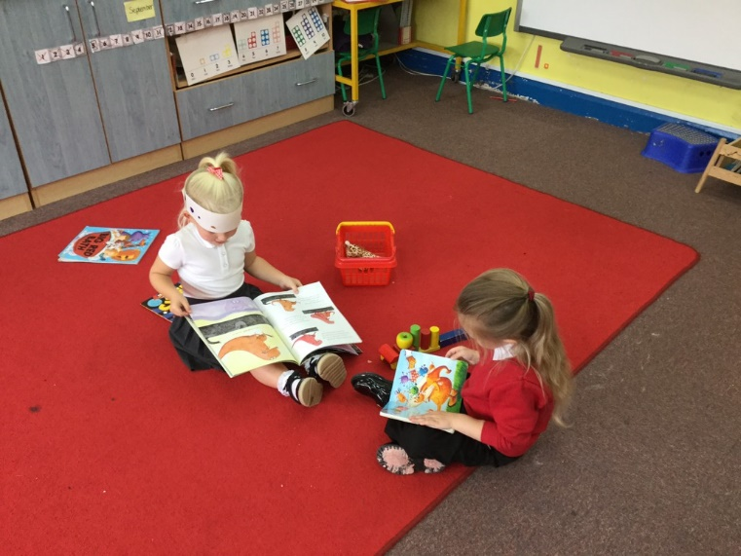
EYFS Curriculum
There are three areas of Literacy in our new early years curriculum.
Comprehension
Word Reading
Writing

Slide 3
EYFS Curriculum
Comprehension
By the end of Reception children should be able to;
Demonstrate understanding of what has been read to them by retelling stories and narratives using their own words and recently introduced vocabulary.
Anticipate (where appropriate) key events in stories.
Use and understand recently introduced vocabulary during discussions about stories, non-fiction, rhymes and poems and during role play.

Slide 4
EYFS Curriculum
Word Reading
By the end of Reception children should be able to;
Say a sound for each letter in the alphabet and at least 10 digraphs.
Read words consistent with their phonic knowledge by sound-blending.
Read aloud simple sentences and books that are consistent with their phonic knowledge, including some common exception words.

Slide 5
EYFS Curriculum
Writing
By the end of Reception children should be able to;
Write recognisable letters, most of which are correctly formed.
Spell words by identifying sounds in them and representing the sounds with a letter or letters.
Write simple phrases and sentences that can be read by others.

Slide 6
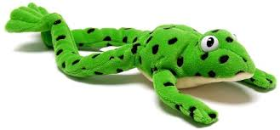
Read Write Inc Phonics
In Whitley Memorial we use a synthetic phonics scheme called Read, Write Inc.
Starts in Nursery and carries on through Key Stage 1
Happens every day
All staff are trained
Begin by learning all 26 simple sounds
Must be the ‘pure’ sounds
Learn to blend to make words ‘Fred Talk’
Learn ‘red tricky words’ by sight

Slide 7
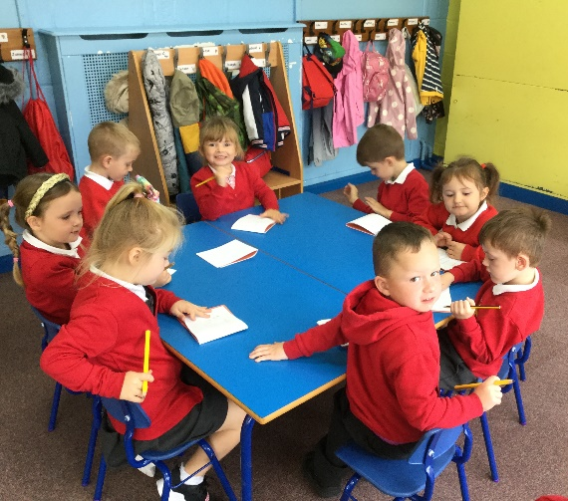
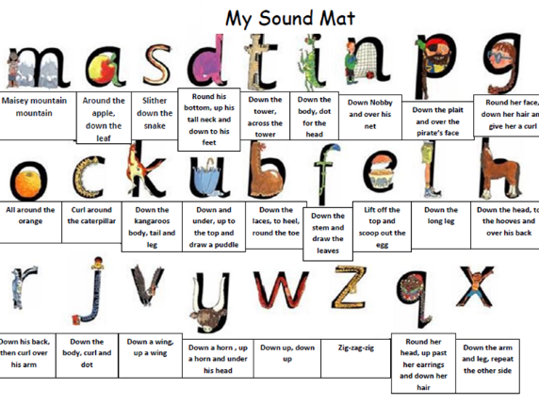

RWI Writing
The pictures on the RWI sound cards relate to the correct letter formation
Children are taught how to segment words ‘Fred fingers’ to help with spelling
Writing letters and words is part of the daily lesson

Slide 8

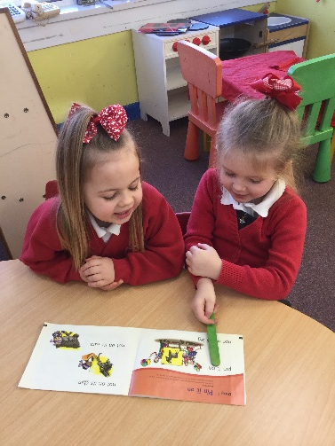
RWI Word Reading
Once children know all the letter sounds and can blend simple words independently they will move on to the RWI books in school.
These are ‘fully decodable’ which means they can sound out all the words.

Slide 9
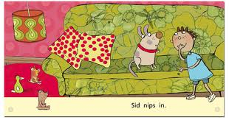
Reading Books
Once children are confident to blend words independently they will be given a reading book to take home.
All books are decodable
Range of fiction and information
Encourage them to talk about what they have read

Slide 10


Reading Books
Reading books are sent home can be read over a number of nights
Parents/carers need to sign in the red reading record before a book can be changed
Reading folders should be brought to school every day

Slide 11



Core Books
We will be following on from Nursery and using ‘core books’ throughout the year.
These are all favourite picture books that the children enjoying listening to and joining in with.
By the end of the year your child should know a number of Core Books by heart.

Slide 12

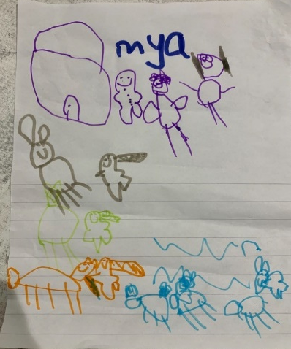

Talk 4 Writing
Some of our Core Books are also Talk 4 Writing books.
These are stories that the children learn and then use to write their own versions of a traditional tale.
So far we have read The Little Red Hen and The Gingerbread Man.

Slide 13
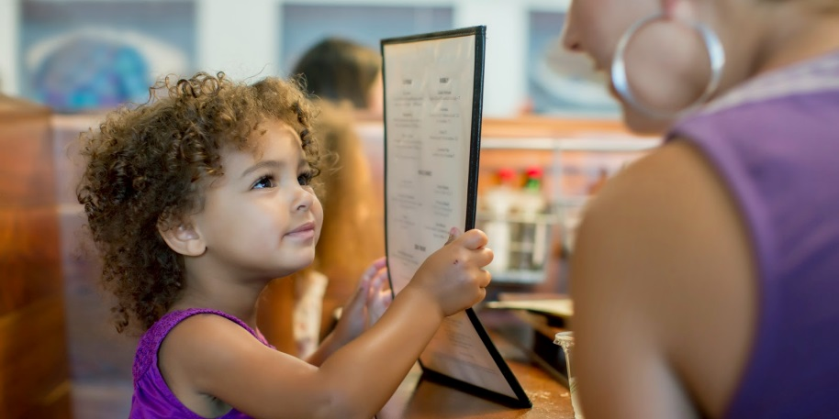
Reading out of school
There are so many opportunities for your child to be involved in reading and many of these happen out of school.
Bedtime stories
Looking at menus
Playing games
Making up stories
Please help us by sharing these moments on Tapestry.

Slide 14



Environmental Print
Opportunities to read can be found anywhere.
Recognising and reading shop signs, logos and environmental print is just as important.

Slide 15

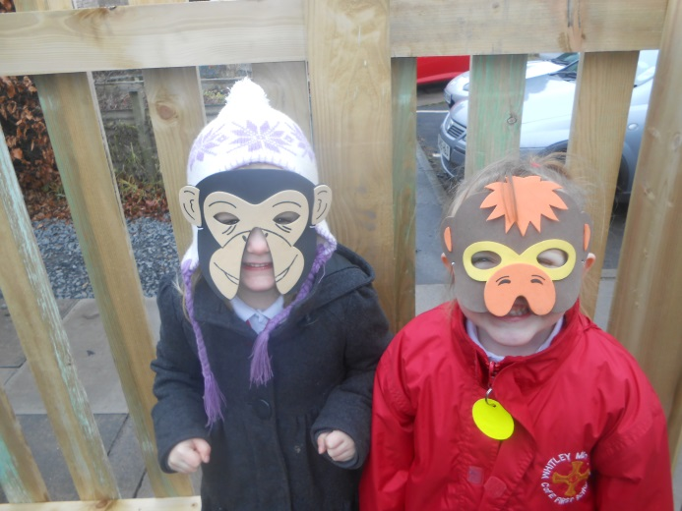
Nursery Rhymes
Nursery rhymes and simple songs are really important to help children learn rhythm, rhymes and alliteration.

Slide 16
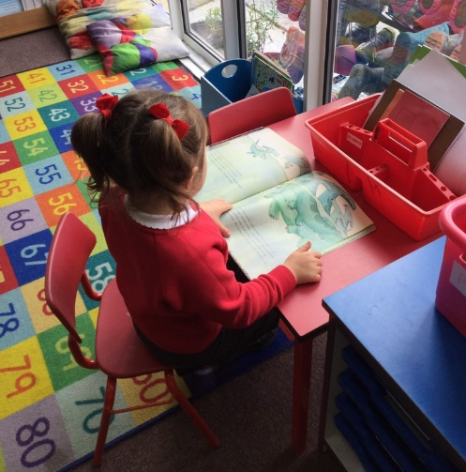
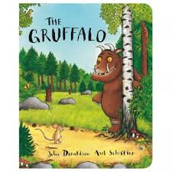
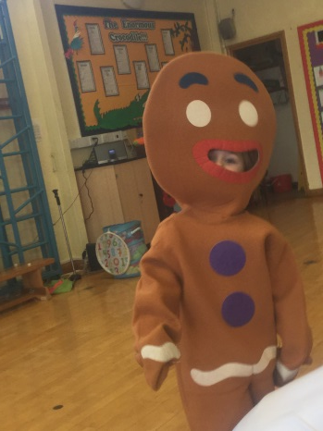
Reading for Enjoyment
Children learn best when they are constantly praised
Reading should be fun
Your children need to be read to so they can access a range of stories, information and vocabulary

Slide 17
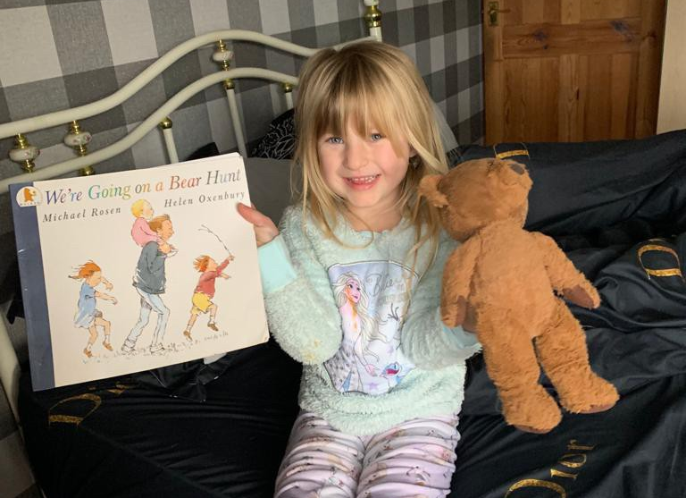
Learning Together
Your child will get regular phonics based homework. It really helps if this is a shared and fun activity.
Each weekend two different children are chosen to share a book with Night Time Reading Bear and return him to school on Monday.

Slide 18

Secret Reader
We have had some brilliant Secret Readers already and hope this can continue (dependent on guidelines)
You can bring a favourite book, or we have plenty in school
We would like this to be a surprise for your child
The children love watching Secret Readers on the big screen too – so feel free to record one for us!

Slide 19

Any Questions?
If you have any questions or feel you need to know more about reading in Reception please send me a note on Tapestry or catch me at the end of the day.
Thank you
Miss Evans
Let your light shine Matthew 5:16

