Slide 1


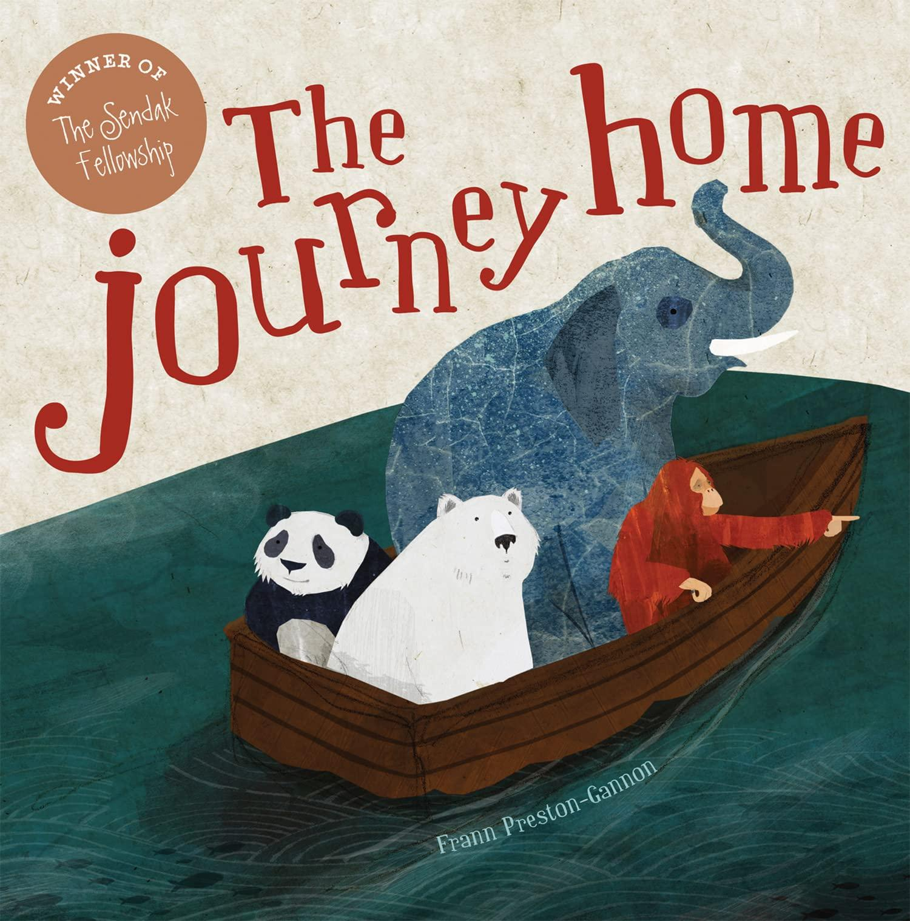
Year 2 - Spring 2 2026
Teacher: Miss Wood
English - In English, we will begin by exploring the story ‘Grandad’s Camper’’ by Harry Woodgate, using it as inspiration to write our own narrative story. Later in the term, we will study ‘The Journey Home’ by Frann Preston Gannon and use the themes from the story to help us write an explanation text.
Humanities- As Geographer’s, we will be learning all about Kenya. We will find out the capital city, spot Kenya on a map, make comparisons to the UK and learn all about the people and wildlife.
Art / DT - Cooking and nutrition. We will be learning about balanced diet. Healthy eating is very important so children will look at preparing, taste testing ingredients and eventually making their own healthy wrap.
Maths - As mathematicians, we will finish our understanding of multiplication and division for the 2’s, 5’s and 10 times table. We will go on to learn about length and height. We will also learn about mass, capacity and temperature. We are also completing bi-weekly tests to check our understanding.
ICT - Staying Safe Online. We will learn how to stay safe online. Children will begin to understand the importance of keeping information private and not talking to strangers online.
Science - In Science, we will continue exploring living things and their habitats. We will focus on understanding food chains, look at key Scientists such as William Kirby and explore key vocabulary like producers, herbivores and carnivores.
Our core value this term is:
Forgiveness
Just as the Lord has forgiven you, so you just also forgive others - Colossians 3:13
Music - In the Zoo. Using the Charanga scheme, we will be singing a song about the zoo together in an ensemble.
PSHE -Rights and Respect. We will learn all about getting on with others, when we feel like erupting and how we can care for our environment.
RE - Why does Easter Matter to Christians? Using St. Cuthbert’s Church as a case study, we will learn about the story of Easter. We will recognise symbolism and how new life is key in this topic. To help with this we have ducklings in class!
PE - This half term we will have PE on Friday with NUFC.

