Slide 1

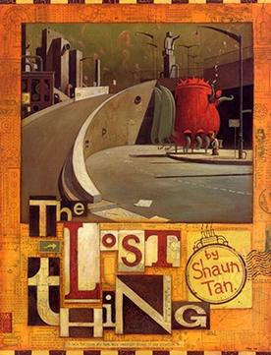

Year 5 – Autumn 1 2025
Teachers: Mrs. Fowler
English - In English, we use the story ‘Lost Things’ as a stimulus to write an adventure story focussing on building character, setting description, suspense and think of word choice to interest the reader. Next, we will research arguments for and against the Titanic disaster to answer the question is the Titanic largely remembered as a triumph or a tragedy?
Geography—Why are mountains so important?
We will learn about the world’s important mountains
and mountain ranges. We will discover how mountains
are formed and compare mountains in the UK to globally.
DT – Our challenge this half term is to research, build and test different types of bridge.
Maths - As mathematicians, we will focus on building our knowledge and application of times table and division facts. We will calculate square, cubed and prime numbers. Furthermore, we will develop our understanding of fractions to compare, order and use in calculations.
ICT: This half term we will be using Scratch Junior to create, debug and create a range of retro style computer games.
Music – In music we will be focussing on jazz and following music to play using glockenspiels.
Science – In science, our unit will be based on forces we will use scientific skills and vocabulary to explore the impact of gravity, friction, water resistance and air resistance.
Our core
value this
term is
Respect
Peter 2:17:
"Show
proper
respect to
everyone".
PSHE: This half term our unit is called ‘Valuing difference’ and focusses on friendship, your qualities, stereotypes and valuing everyone’s qualities.
French – We will continue our unit to focus on French pronunciation.
RE – Our unit is named ‘Was Jesus the Messiah? where we will use a range of extracts to explore and respond to this question and think about how many Christians celebrate Christmas.
PE - This half term we will have coaching by NUFC on a Tuesday and swimming on a Friday.

