Slide 1

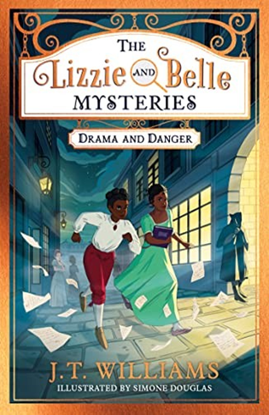

Year 5 - Spring 1 2026
Teachers: Mrs. Fowler
English - In English, we will begin by exploring the story ‘The Lizzie and Belle Mysteries’ by J. T. Williams, using it as inspiration to write our own diary recounts. Later in the term, we will study ‘’The Wonderling’’ by Mira Bartok and use the themes from the story to help us write a persuasive letter.
Humanities- As geographers we will be investigating rivers of the world; focussing on features, map work and flooding.
DT - We will be learning about sculpture and 3D:
interactive installations.
Maths - As mathematicians, we will focus on using written methods for multiplication and division and apply this knowledge to solve a range of reasoning and problem-solving questions. We will develop our knowledge of fractions to multiply fractions, find fractions of amounts and to use fractions as operators.
ICT: Our unit is called ‘Building Collaborative websites’ and uses Google apps for collaborative research as well as planning and creation of a group website, considering the design and consistency of the site.
Music – This unit ‘Make You Feel My Love’ centres around appraising, learning and performing ballads.
Science – In science, we will investigate Properties and changes of material by researching the purpose and functionality, solutes and solvents also reversible and irreversible changes. Whilst developing a range of scientific skills we will also build our scientific vocabulary.
PSHE: Keeping myself safe explores aspects of keeping safe; safe internet use, drugs and relationship education.
Our core value this term is:
LOVE
John 15:12:
"Love one another other as I have loved you"
French - ‘Ma famille’ is centred around naming family members, describing them and counting to 100.
RE - What does it mean for a Jewish person to follow God? We will explore why the Torah is so important to Jewish people and how it is used as a source.
PE - This half term we will have Gym on a Thursday and swimming on a Friday.

